Slide 1
4
The future of apps
4

Slide 2
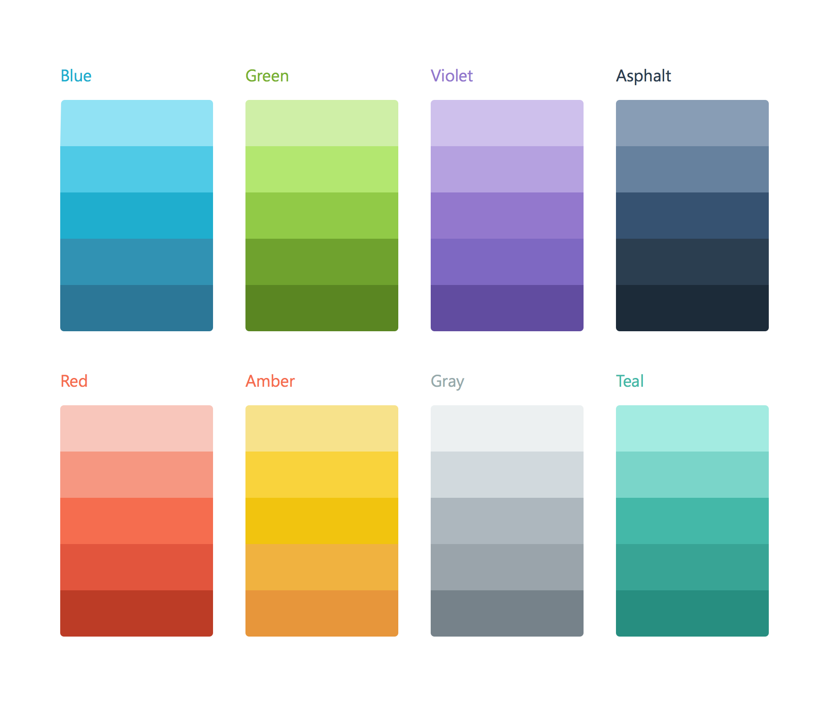

Historiek
Miguel de Icaza
GNOME, Mono
Gestart in 2011
Overgenomen door Microsoft
Beschikbaar op GitHub
https://github.com/xamarin
Bronnen: https://en.wikipedia.org/wiki/Xamarin http://tirania.org/blog/archive/2011/May-16.html

Slide 3
Ontwikkeling van apps

Slide 4
Xamarin aanpak
iOS C# UI
Android C# UI
Windows C# UI
Shared C# Mobile
Shared C# codebase • 100% native API access • High performance
Notes:
UI build natively per platform, leveraging C#
C# + XAML
C# + XML
C# + XIB
One shared app logic code base, iOS, Android, Mac, Windows Phone, Windows Store, Windows

Slide 5
Xamarin – Mobile Solution
BUILD
TEST
MONITOR
ACCELERATE
Notes:
Xamarin is your complete mobile solution.
Xamarin Platform is usually what you hear about which is building native iOS, Android, Mac, and Windows Apps all in C#
However Xamarin offers a wide range of products for developers to go mobile including Test Cloud, Insights, and a way to learn all of mobile with University.

Slide 6
Xamarin Platform
BUILD
TEST
MONITOR
ACCELERATE
Notes:
Xamarin is your complete mobile solution.
Xamarin Platform is usually what you hear about which is building native iOS, Android, Mac, and Windows Apps all in C#
However Xamarin offers a wide range of products for developers to go mobile including Test Cloud, Insights, and a way to learn all of mobile with University.

Slide 7
✓Always Up-to-Date
Same-day support:
iOS 5
iOS 6
iOS 7
iOS 7.1
iOS 8
iOS 9
Full support for:
Apple Watch
Google Glass
Android Wear
Amazon Fire TV
and much more
Notes:
Apple has a developer preview where Xamarin has alphas ready. Google does not offer this.
Android versions are usually 4 to 8 weeks out for a stable release, but alphas and betas are usually earlier.
Xamarin realizes how important having iOS ready because within 24 hours a large portion of iOS users upgrade
Android on the other hand is much different. After 4 months on the market Android 4.4 only had 1% adoption

Slide 8
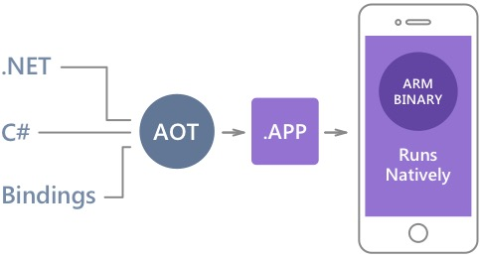
Native performance
Xamarin.iOS maakt gebruik van Ahead Of Time (AOT) compilation
Xamarin.Android maakt gebruik van Just In Time (JIT) compilation
Notes:
There is no compromise on performance.
Xamarin apps look and feel native because they are native.

Slide 9
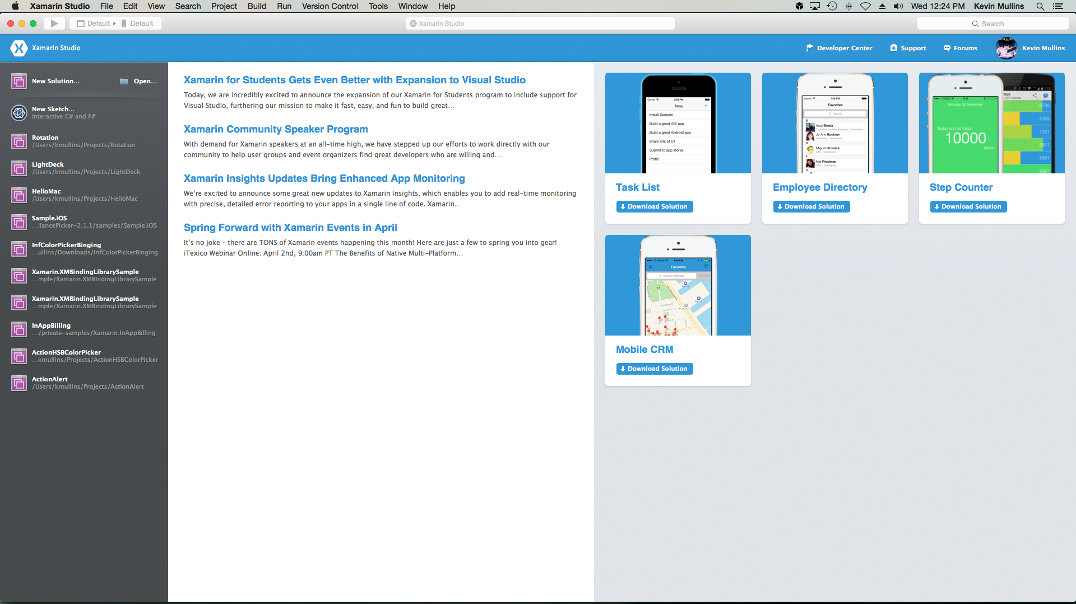
Tools – Xamarin Studio

Slide 10
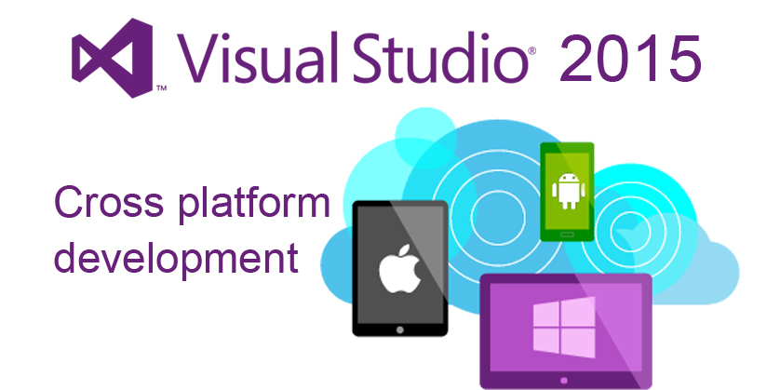
Tools – Visual Studio
Notes:
Mac OS X build host

Slide 11
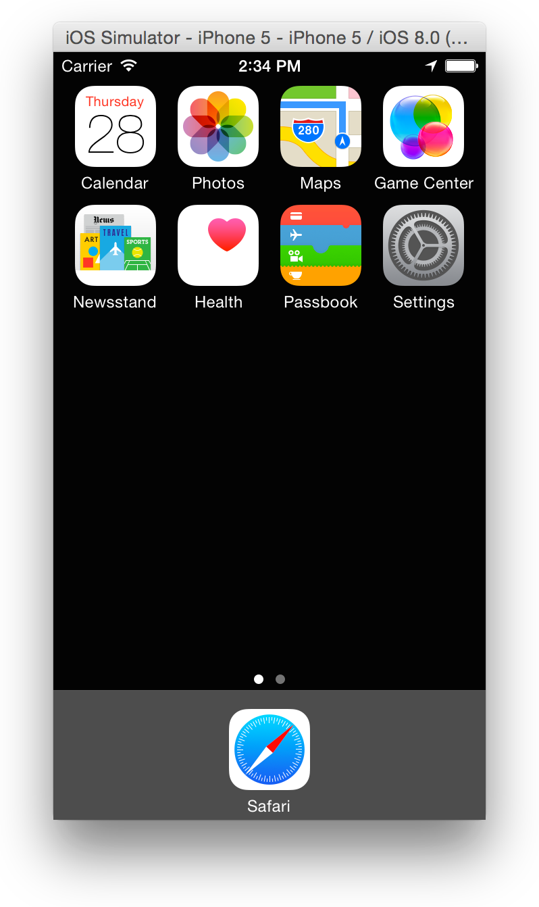
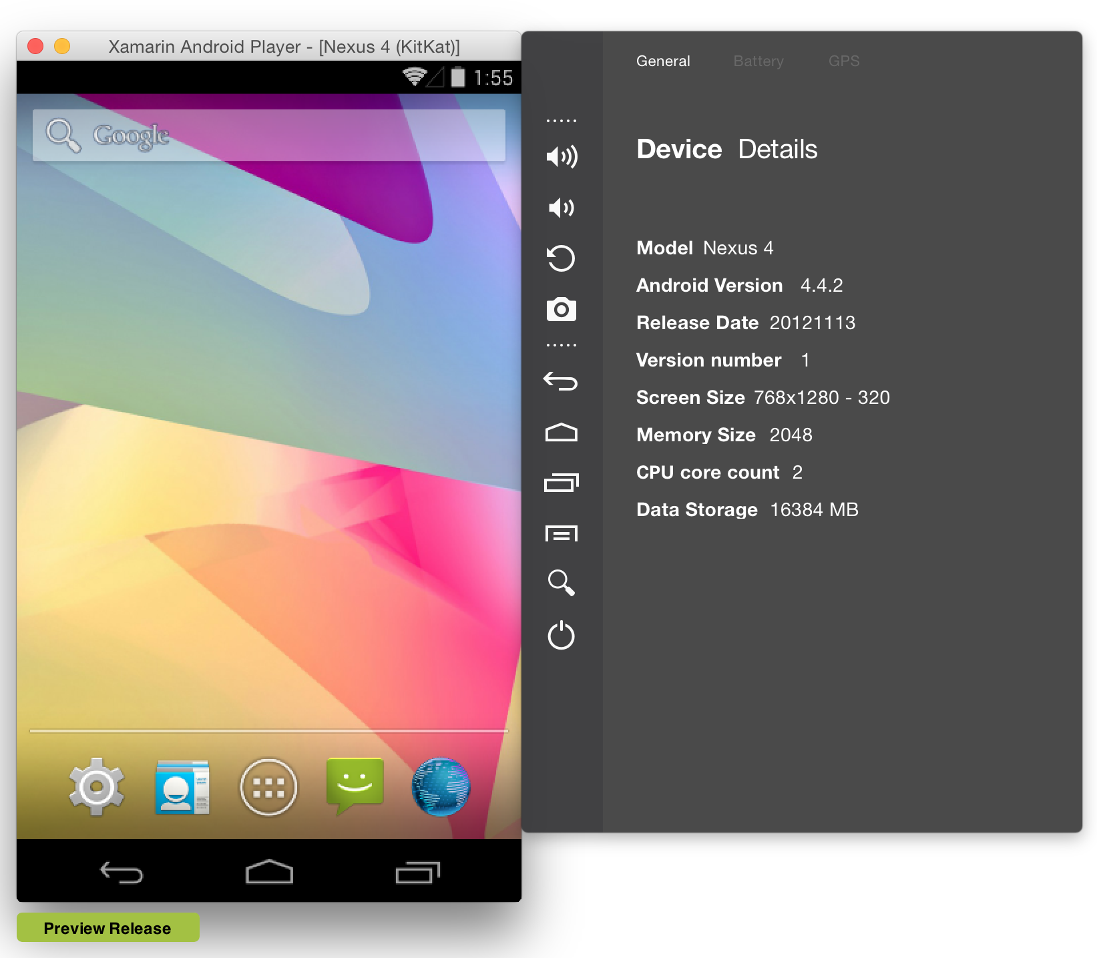
Tools – Emulators
Android
Xamarin Android Player
Genymotion
Android AVD emulators
iOS
Xcode iOS simulator

Slide 12
Demo – iOS app

Slide 13
Android
Activities
Fragments
Layouts

Slide 14
Android – Layouts
LinearLayout
RelativeLayout
FrameLayout
TableLayout

Slide 15
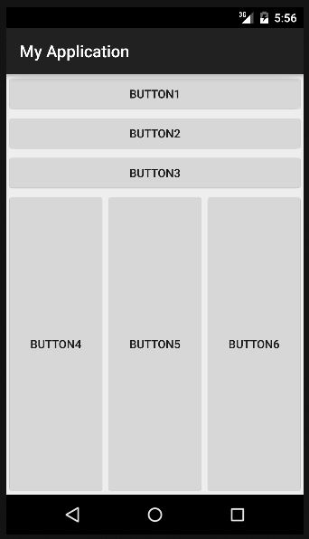
Android – LinearLayout

Slide 16
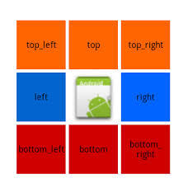
Android – RelativeLayout

Slide 17
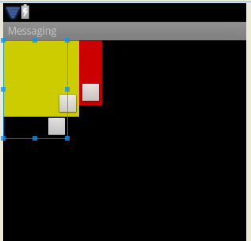
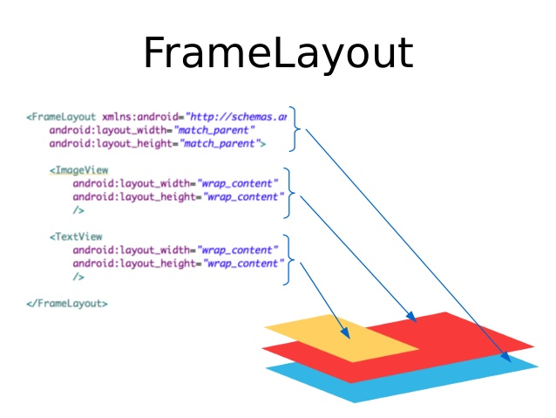
Android – FrameLayout

Slide 18
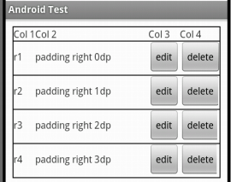
Android – TableLayout

Slide 19
Demo –Android app

Slide 20
PCL vs Shared projects
Twee manieren om aan code sharing te doen
Shared projects
Gebaseerd op compiler directives (#if __ANDROID__)
Geen aparte DLL als output
Moeilijker refactoren door inactieve code
PCL
Makkelijker hergebruik van code over verschillende projecten
Platform specifieke functionaliteit kan niet gebruikt worden
Notes:
PCL
When you create a ‘regular’ Application Project or a Library Project, the resulting DLL is restricted to working on the specific platform it is created for. This prevents you from writing an assembly for a Windows Phone app, and then re-using it on Xamarin.iOS and Xamarin.Android.
The Portable Class Library project enables you to write and build managed assemblies that work on more than one .NET Framework platform. You can create classes that contain code you wish to share across many projects, such as shared business logic, and then reference those classes from different types of projects.
Using the Portable Class Library project, you can build portable assemblies that work without modification on the .NET Framework, Silverlight, Windows Phone 7, or Xbox 360 platforms. Without the Portable Class Library project, you must target a single platform and then manually rework the class library for other platforms. The Portable Class Library project supports a subset of assemblies from these platforms, and provides a Visual Studio template that makes it possible to build assemblies that run without modification on these platforms.
Benefits
Centralized code sharing – write and test code in a single project that can be consumed by other libraries or applications.
Refactoring operations will affect all code loaded in the solution (the Portable Class Library and the platform-specific projects).
The PCL project can be easily referenced by other projects in a solution, or the output assembly can be shared for others to reference in their solutions.
Disadvantages
Because the same Portable Class Library is shared between multiple applications, platform-specific libraries cannot be referenced (eg. Community.CsharpSqlite.WP7).
The Portable Class Library subset may not include classes that would otherwise be available in both MonoTouch and Mono for Android (such as DllImport or System.IO.File).

Slide 21
Demo – PCL/Shared projects

Slide 22
Xamarin vs Xamarin.Forms
iOS C# UI
Android C# UI
Windows C# UI
Shared UI Code
Shared C# Backend
Shared C# Backend
Gedeelde business logica
Layout nog per platform te maken
Nog meer gedeelde code door sharen van de UI
Notes:
Xamarin recently introduced Xamarin.Forms a new library for cross platform user interface. We will touch up on this later, but this enables you to be highly productive, share code, but build out UI on each platform and access platform APIs.
With Xamarin.Forms you now have a nice Shared UI Code layer, but still access to platform APIs
You can start from native, pick a few screens, or start with forms, and replace with native later

Slide 23
Demo – Xamarin.Forms

Slide 24
Xamarin – Insights
BUILD
TEST
MONITOR
ACCELERATE
Notes:
Xamarin is your complete mobile solution.
Xamarin Platform is usually what you hear about which is building native iOS, Android, Mac, and Windows Apps all in C#
However Xamarin offers a wide range of products for developers to go mobile including Test Cloud, Insights, and a way to learn all of mobile with University.

Slide 25
Xamarin Insights – Real-time monitoring
✓ Xamarin.iOS
✓ Xamarin.Android
✓ Xamarin.Mac
✓ Windows Phone
✓ Windows Store
✓ Windows Desktop
Notes:
Xamarin.Insights, currently in preview, enables us to support all of our apps from a full cross platform API.

Slide 26
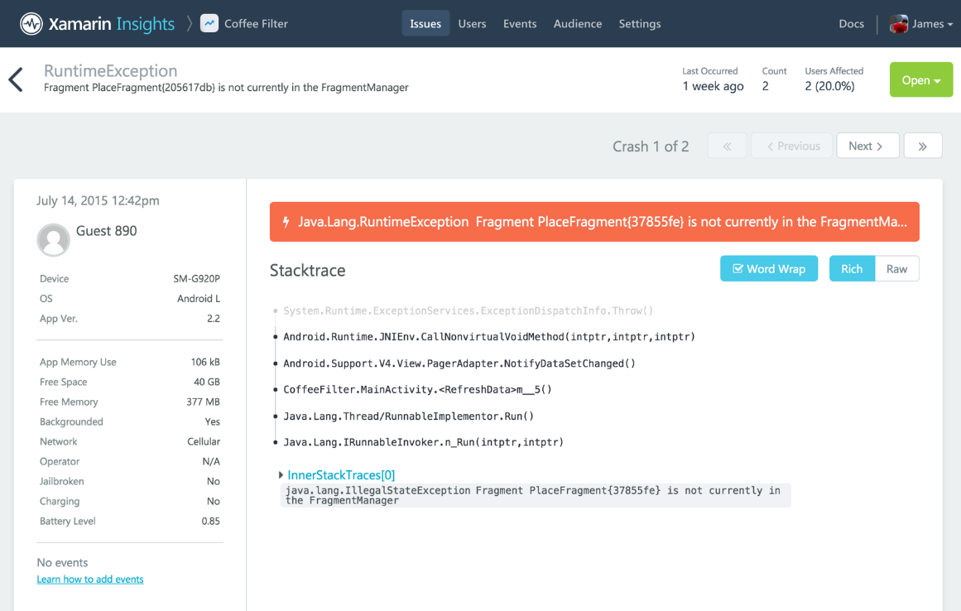
Xamarin Insights – Report
Automatisch rapporten van uncaught exceptions of native exceptions.
Rapporteren van eigen opgevangen fouten.

Slide 27
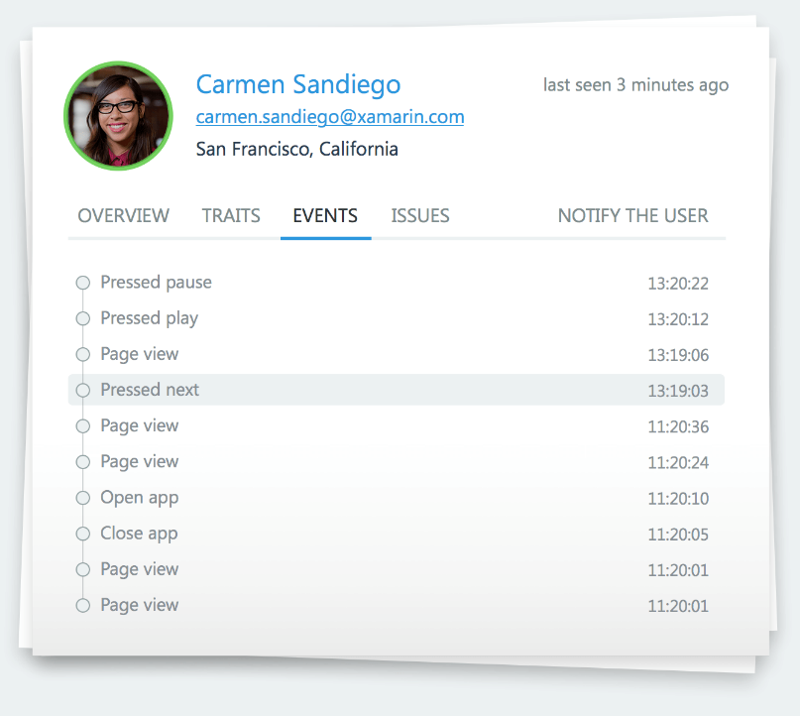
Xamarin Insights – Track
Traceren van events in de app en hoelang een specifiek event heeft geduurd.

Slide 28
Xamarin Insights – Identify
Combineren van foutafhandeling of events met gebruikergegevens.

Slide 29



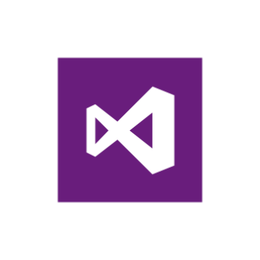
Xamarin Insights – Integratie
Integratie met verschillende online platformen
Notes:
Xamarin.Insights, currently in preview, enables us to support all of our apps from a full cross platform API.

Slide 30
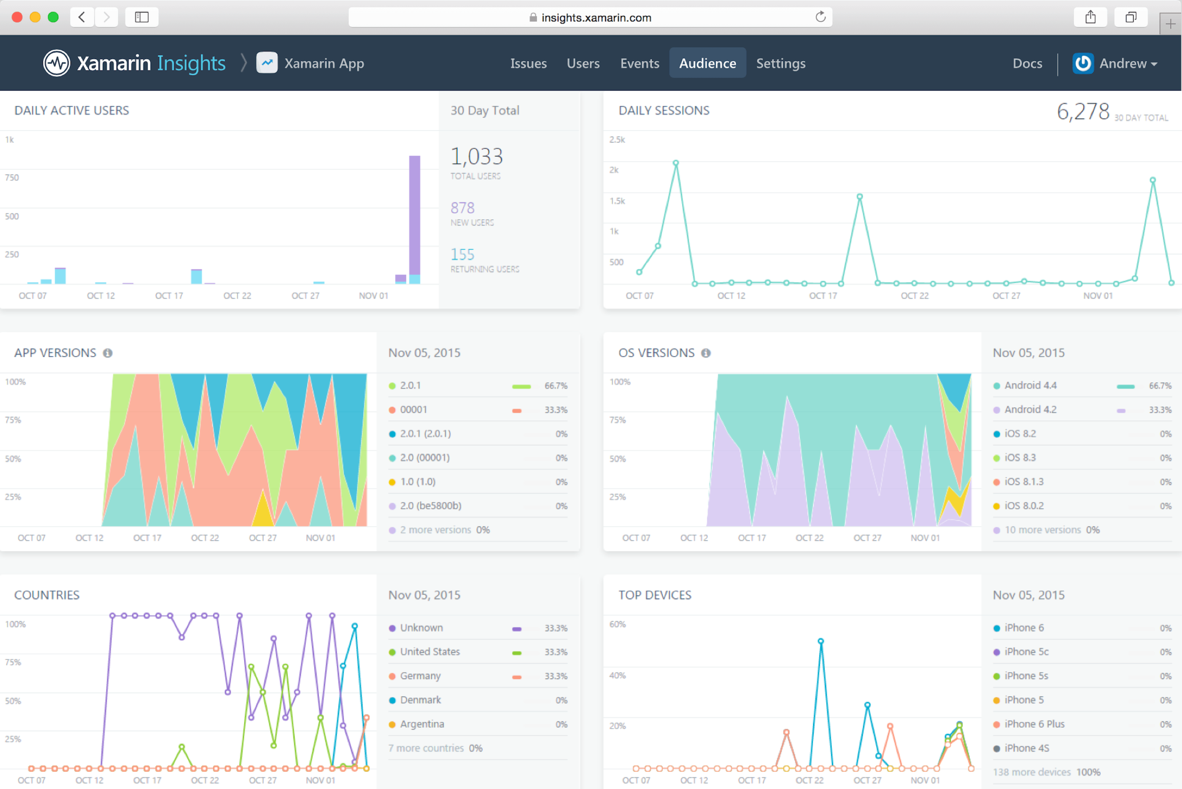
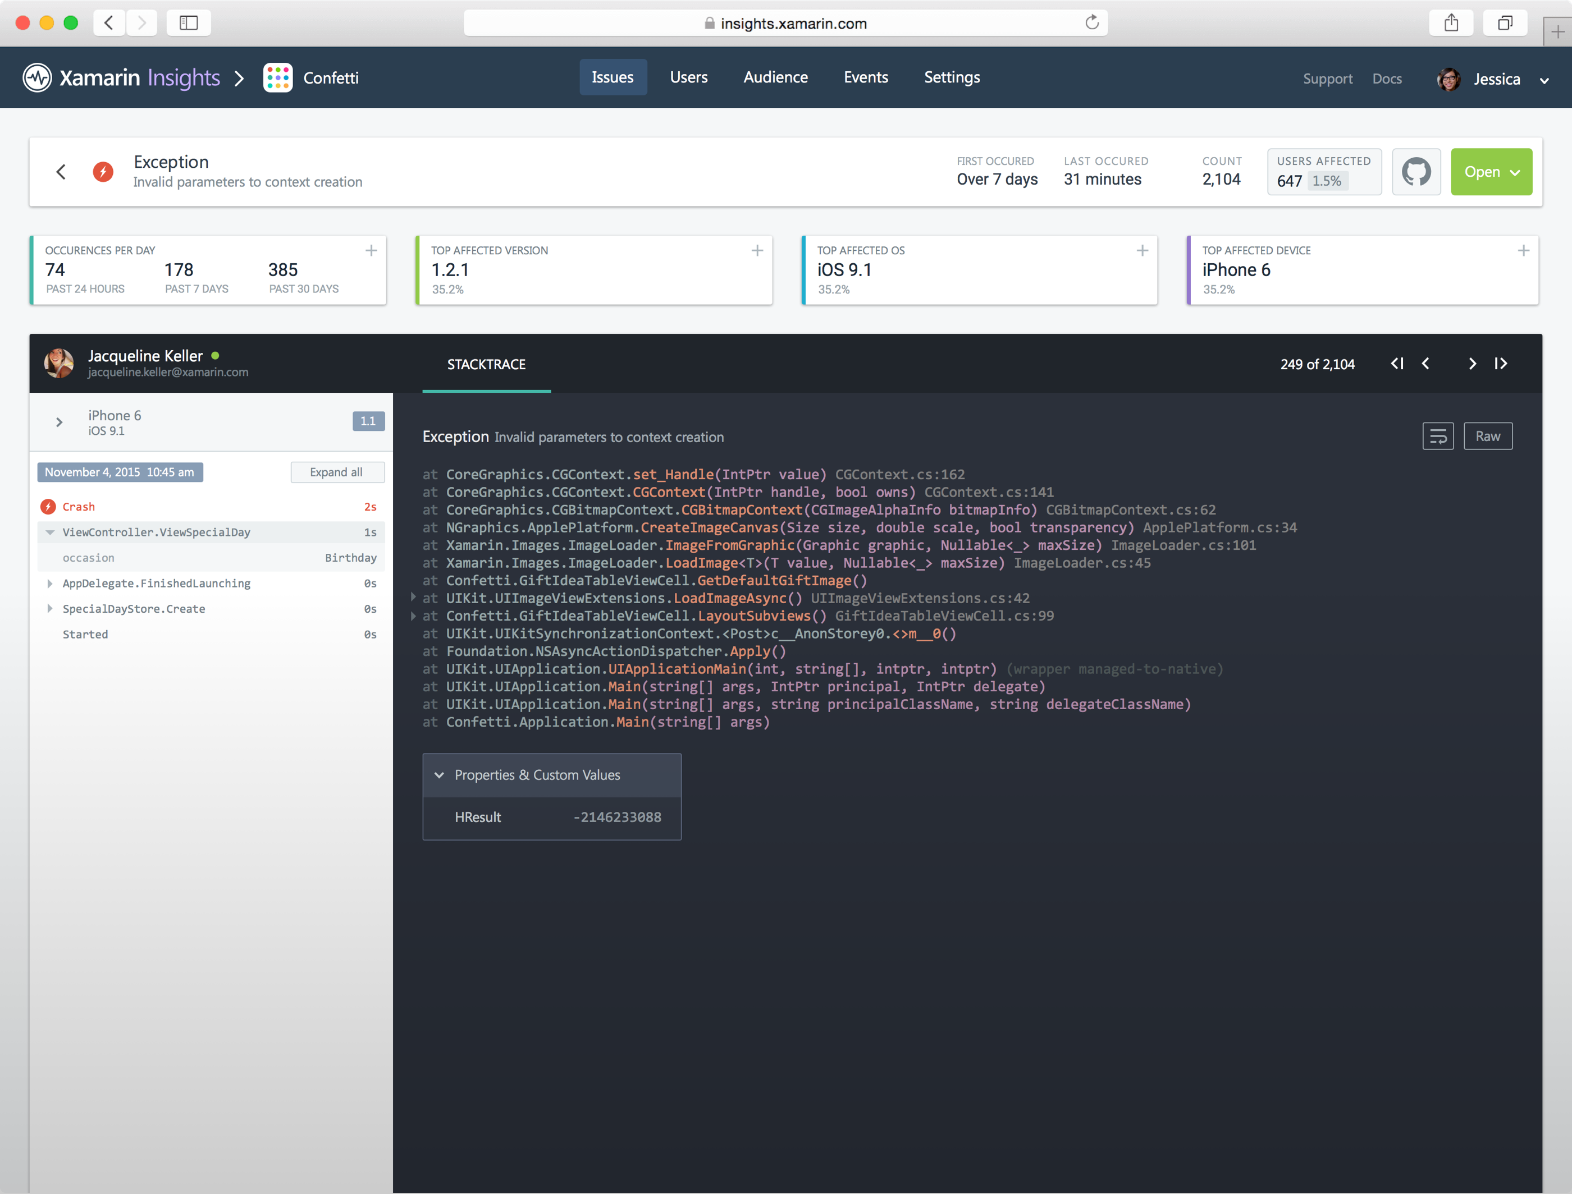
Introducing Xamarin Insights
//Crash Report
Insights.Report(exception);
//Feature Usage
Insights.Track(“Splash Page”);
//Timed Events
Insights.TrackTime(“TimeToSync”);
//User Sessions
Insights.Identify(“Steve”, user_traits);

Slide 31
Xamarin – Test Cloud
BUILD
TEST
MONITOR
ACCELERATE
Notes:
Xamarin is your complete mobile solution.
Xamarin Platform is usually what you hear about which is building native iOS, Android, Mac, and Windows Apps all in C#
However Xamarin offers a wide range of products for developers to go mobile including Test Cloud, Insights, and a way to learn all of mobile with University.

Slide 32
Device Fragmentation
App Complexity
Fast Release Cycles
Short Sessions
High Mobile User Expectations
Challenges
Notes:
Well there are several challenges that we must overcome as mobile developers including….

Slide 33
On Mobile, Quality is Hard
7
20
20
35
6
OS versions
Devices
Languages
Locales
Screen sizes
10
24K+
39
57
27
15
6
OS versions
Distinct devices
Languages
Locales
Screen sizes
Manufacturers
Screen configurations
8
Notes:
First let’s take a look at the shear number of configurations there are between iOS and Android. As iOS progresses this number is only set to increase, and on Android it is already a HUGE number of configurations to even think about testing.
iOS: 7, 7.1, 8, 8.1, 8.2, and iOS 9, iOS 9.1

Slide 34
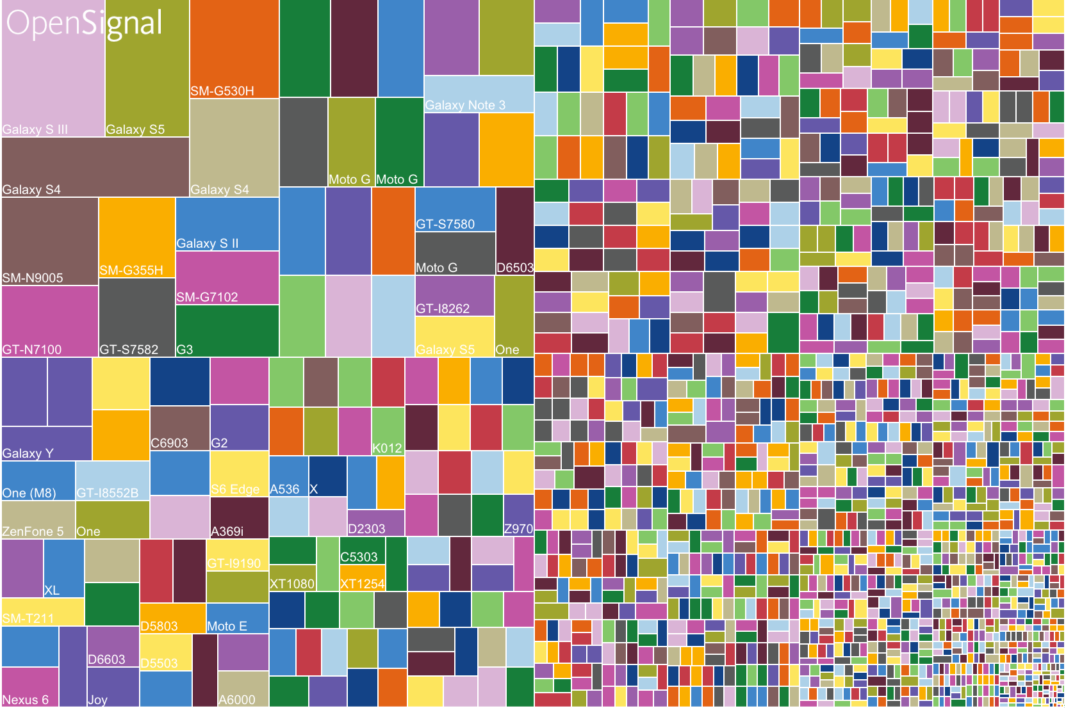
Android diversification

Slide 35
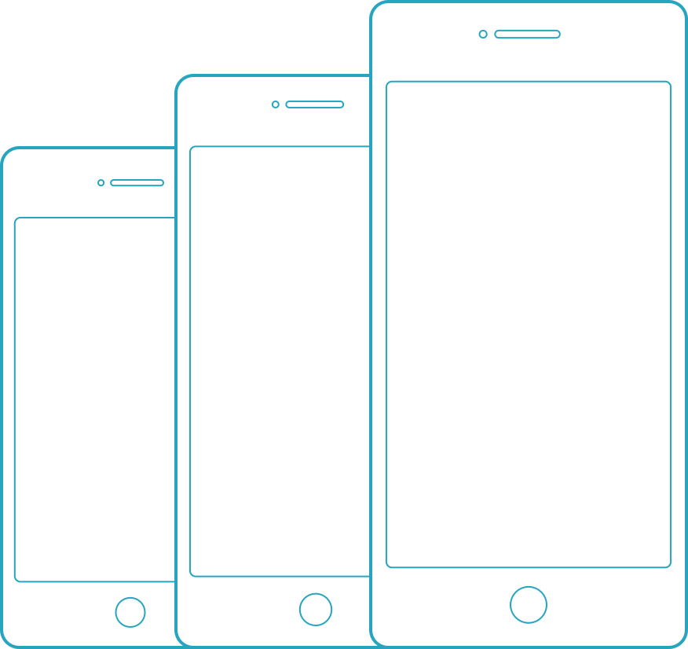
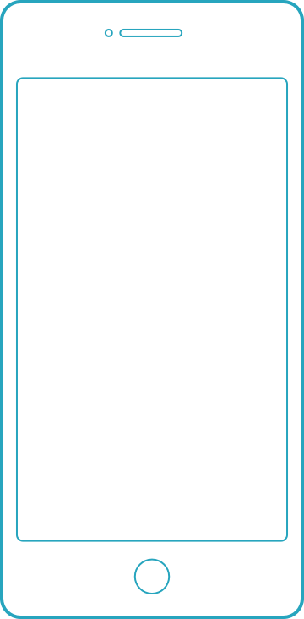
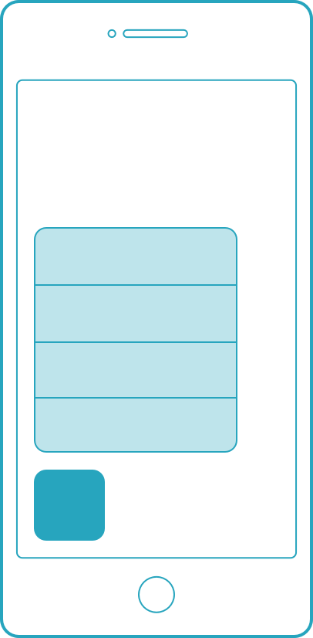
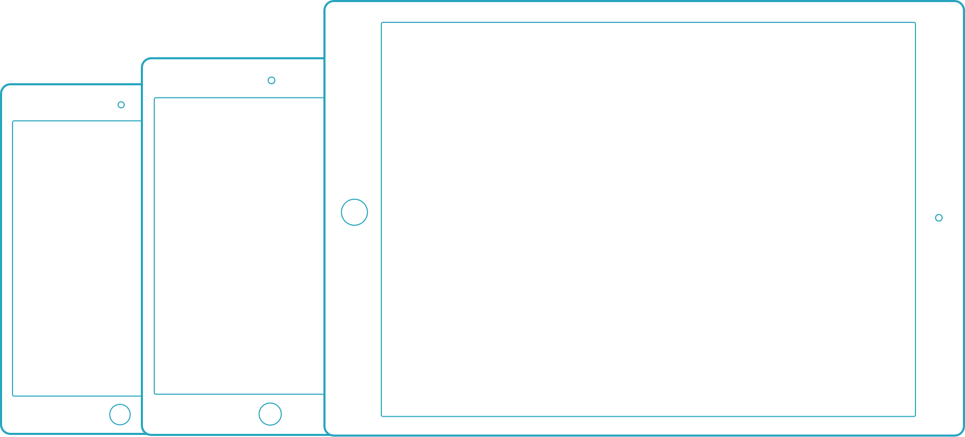
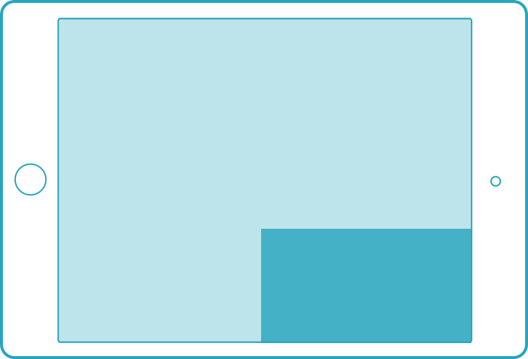
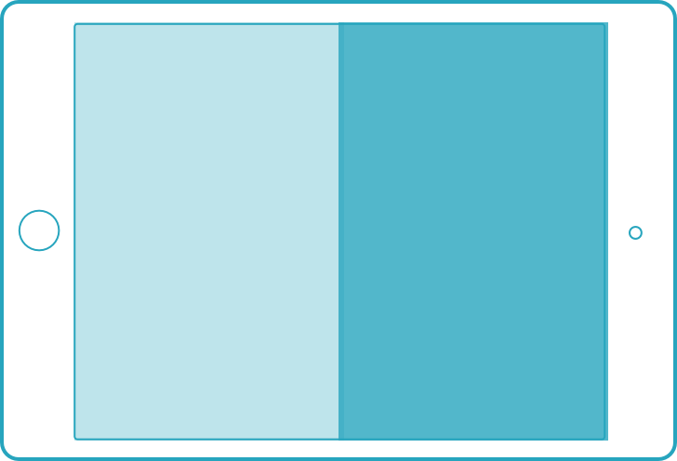
iOS diversification
3D Touch
Apple pencil
iPhones
iPod touch
iPad Pro only
iPhone 6s series only
iPads
Multi Tasking
Only select iPads
Form factors
iOS 9 features

Slide 36
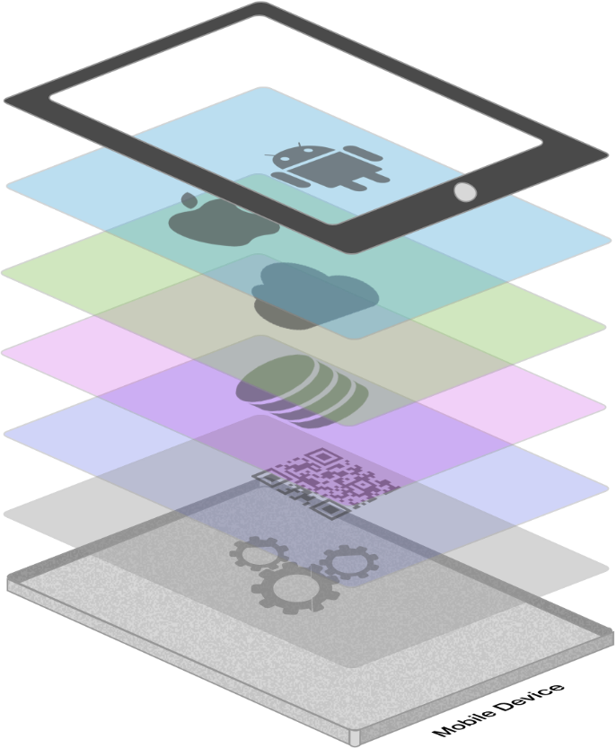







App Complexity
Thousands of iOS and Android APIs
Public web APIs
Backend integrations
Third party libraries
Memory, CPU and network constraints
Notes:
The fragmentation isn’t just in the devices, but as we start to build on our applications you soon found out they are ever increasingly complex.

Slide 37








Tap
Scroll
Swipe
Pinch
Multi Finger
Text Entry
Rotation
GPS
Notes:
With a simple command you can simulate all of your users interactions to build out a great test suite that can be run over and over again.

Slide 38
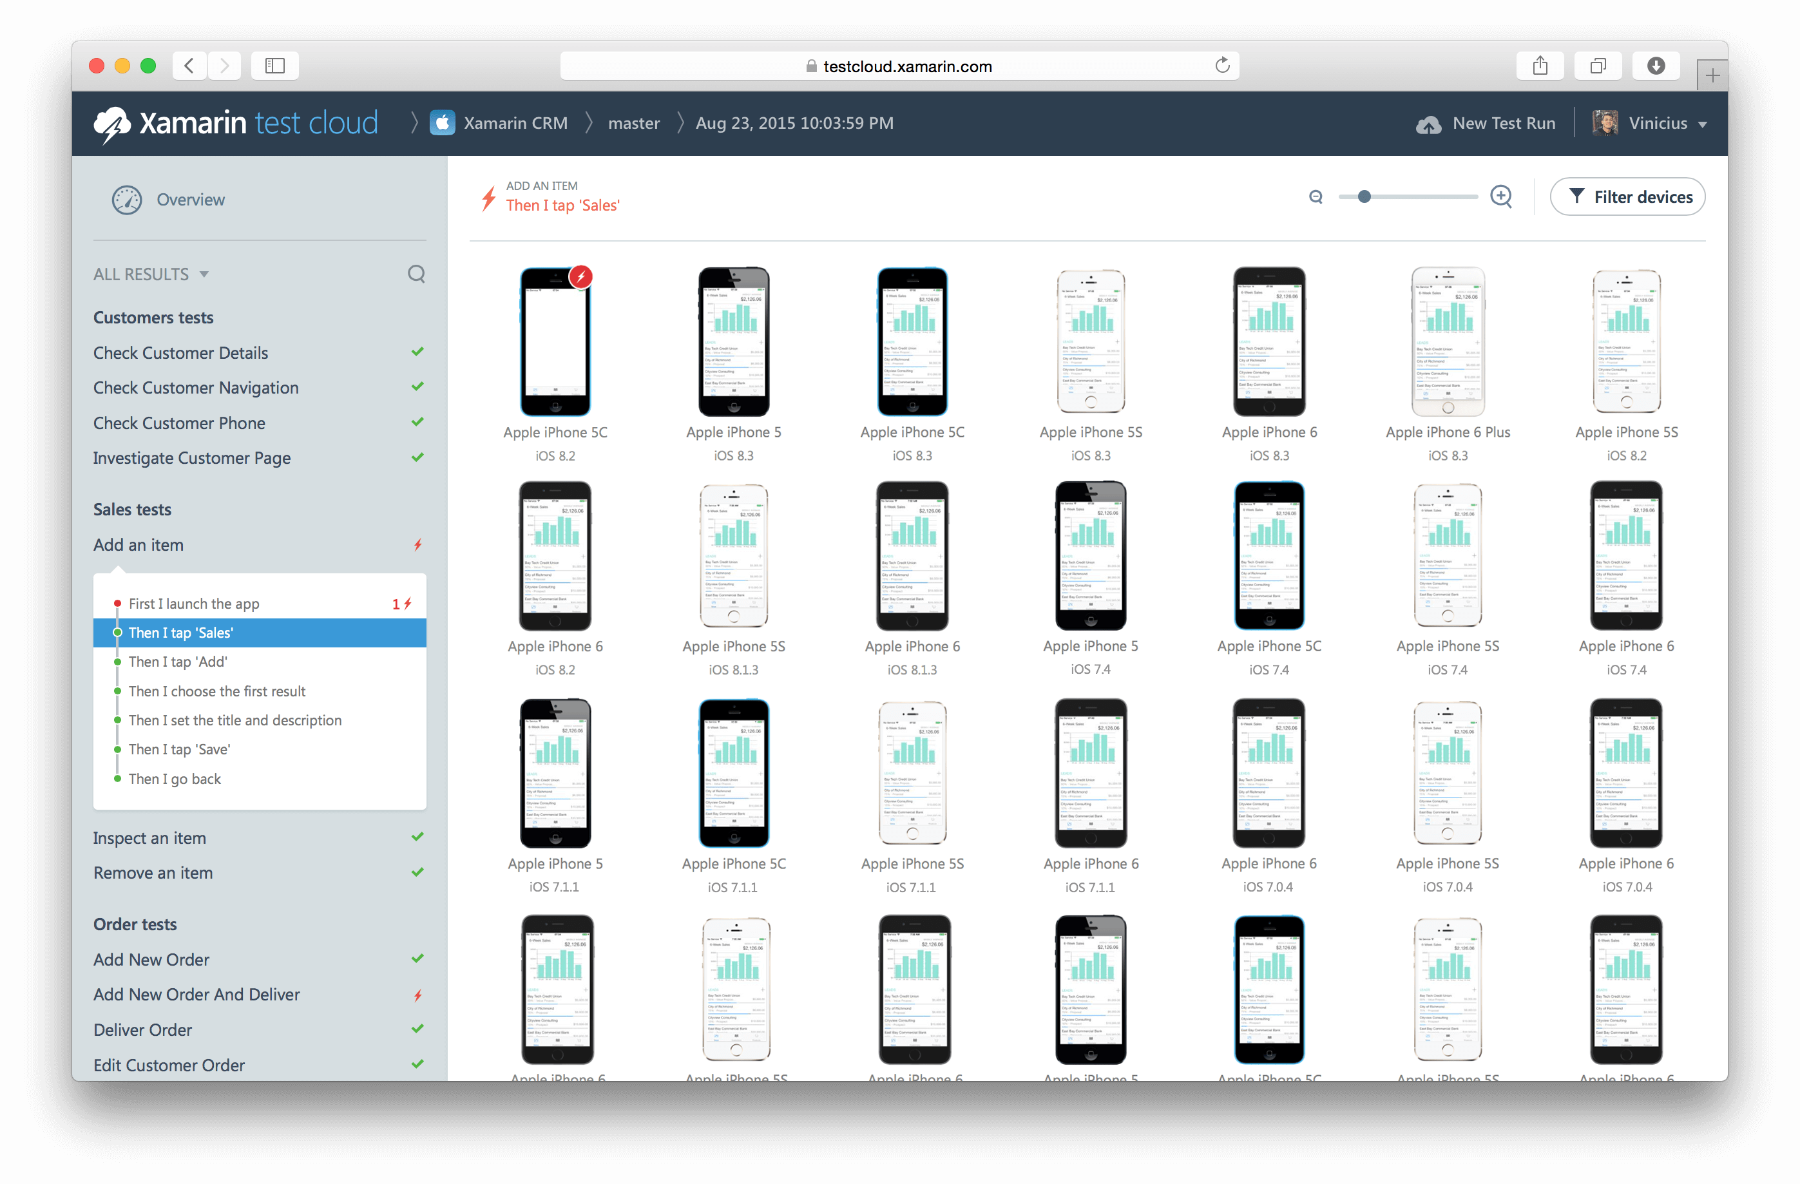
Xamarin Test Cloud: automated testing on thousands of devices

Slide 39
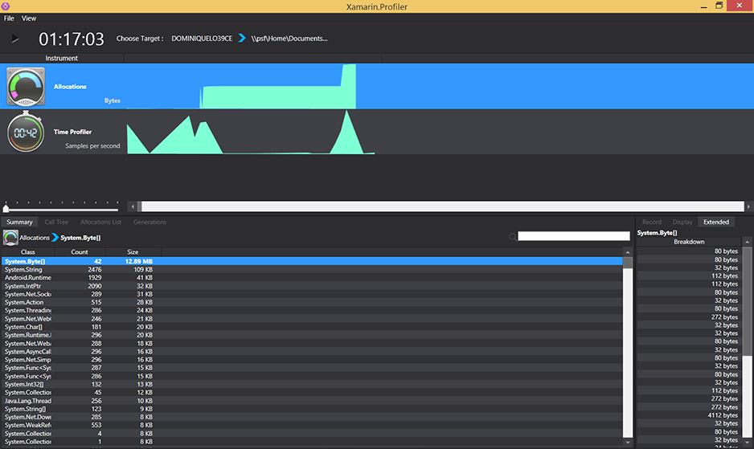
Xamarin – Profiler
Notes:
Xamarin is your complete mobile solution.
Xamarin Platform is usually what you hear about which is building native iOS, Android, Mac, and Windows Apps all in C#
However Xamarin offers a wide range of products for developers to go mobile including Test Cloud, Insights, and a way to learn all of mobile with University.

Slide 40

evolve.xamarin.com

Slide 41
Vragen?

